Slide 1
Lecture 4: periodic table
California State University, Fullerton
2023 Fall Semester – Chem 123

Slide 2
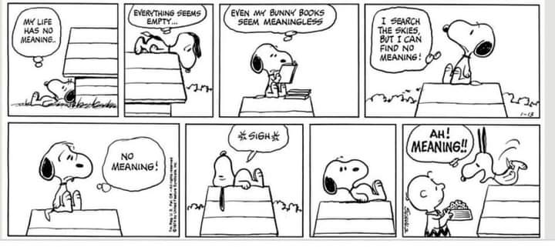
QUESTIONS, COMMENTS, AND CONCERNS?

Slide 3
Outline
Announcements
Ch. 2: Interpreting Periodic Table
Ch. 3: Compounds and the Mole
Chemical formulas
Naming ionic and binary covalent compounds, and acids
Mole concept and molar mass
% composition, molecular formula, and empirical formula

Slide 4
Annoucements
Waitlist students – see after class
Picking up the pace – Ch 3, 4, & 5 are the harder to grasp conceptually
Do practice problems at the end of the textbook
First exam week 5 on Weds, Sept 20th – covering Ch 1-5; 5-6 free response questions

Slide 5
Outline
Announcements
Ch. 2: Interpreting Periodic Table
Ch. 3: Compounds and the Mole
Chemical formulas
Naming ionic and binary covalent compounds, and acids
Mole concept and molar mass
% composition, molecular formula, and empirical formula

Slide 6
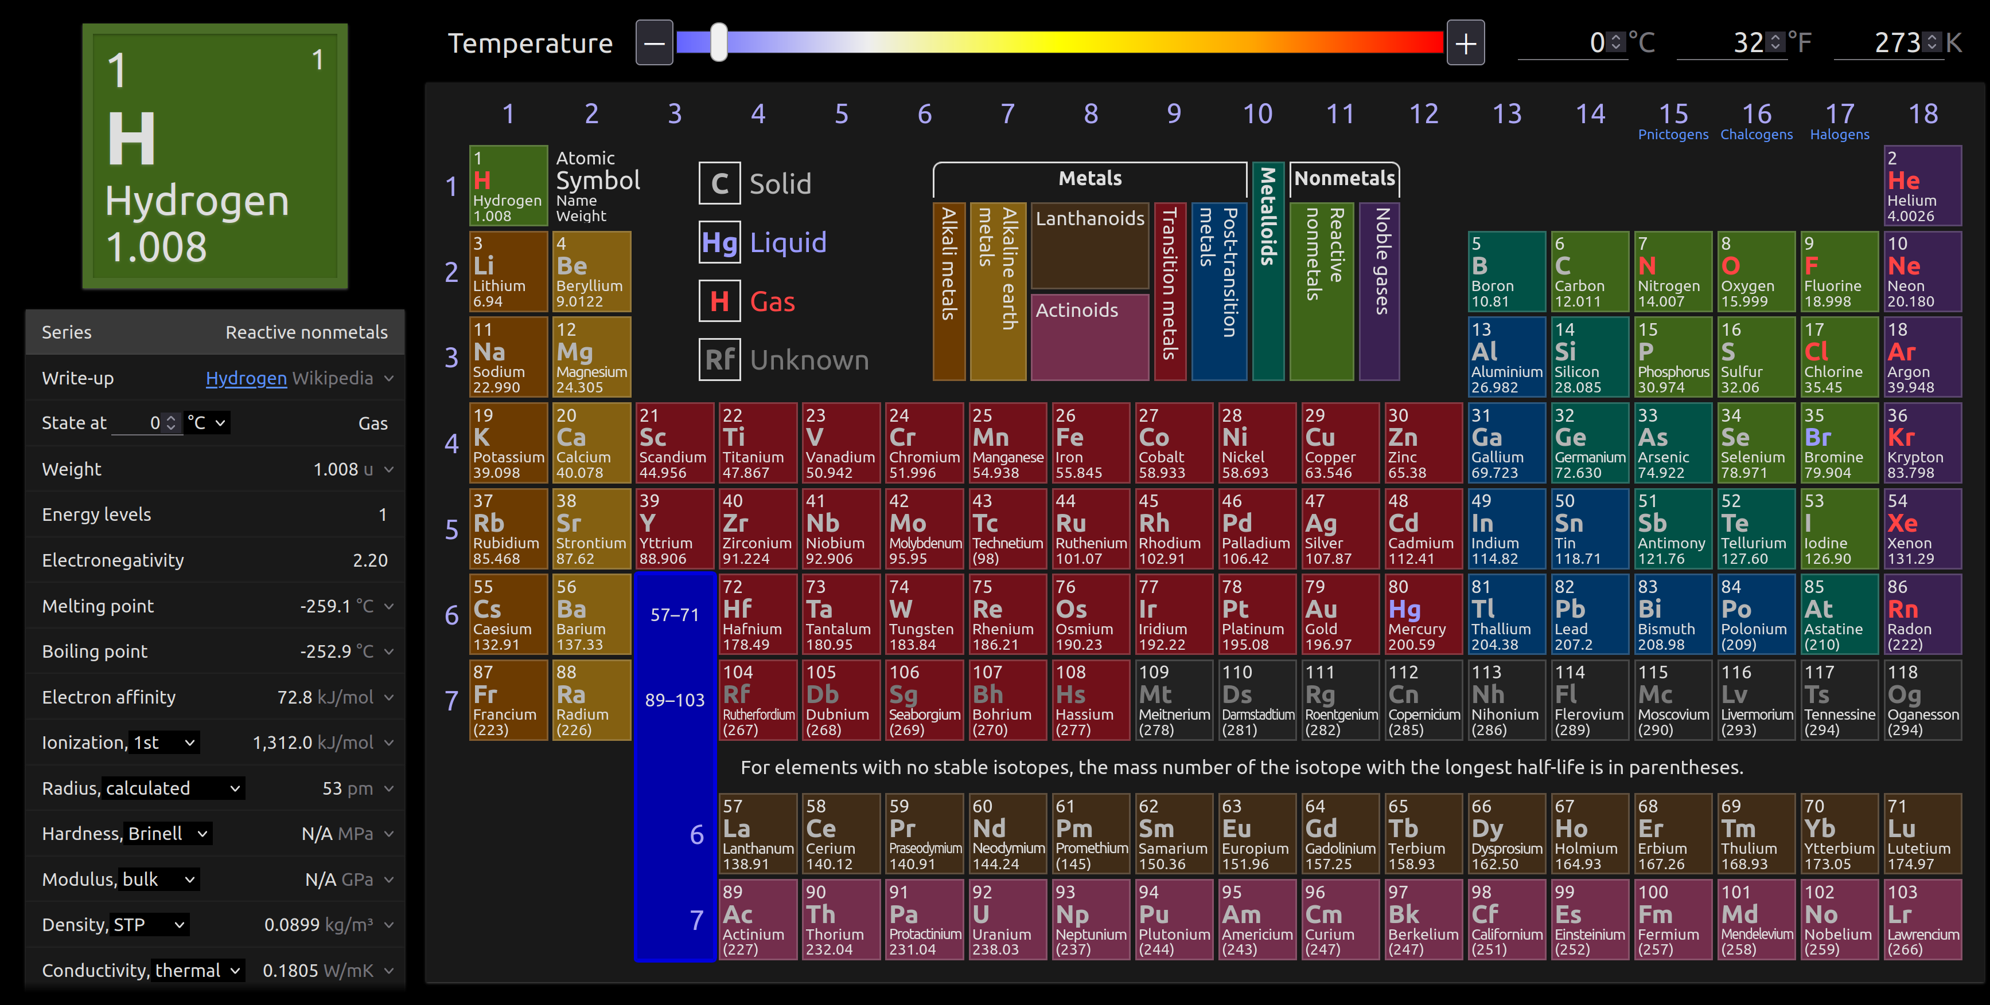
Periodic Table – Use ptable.com

Slide 7
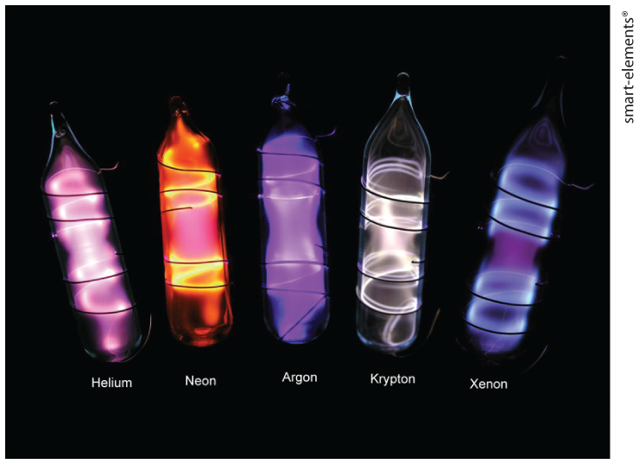
Group 18: Noble gases
Colorless, odorless, and almost totally inert (nearly reactionless)
In terms of stability, main group elements want to obtain similar state as noble gases
Isoelectronic elements – same number of valence electrons

Slide 8
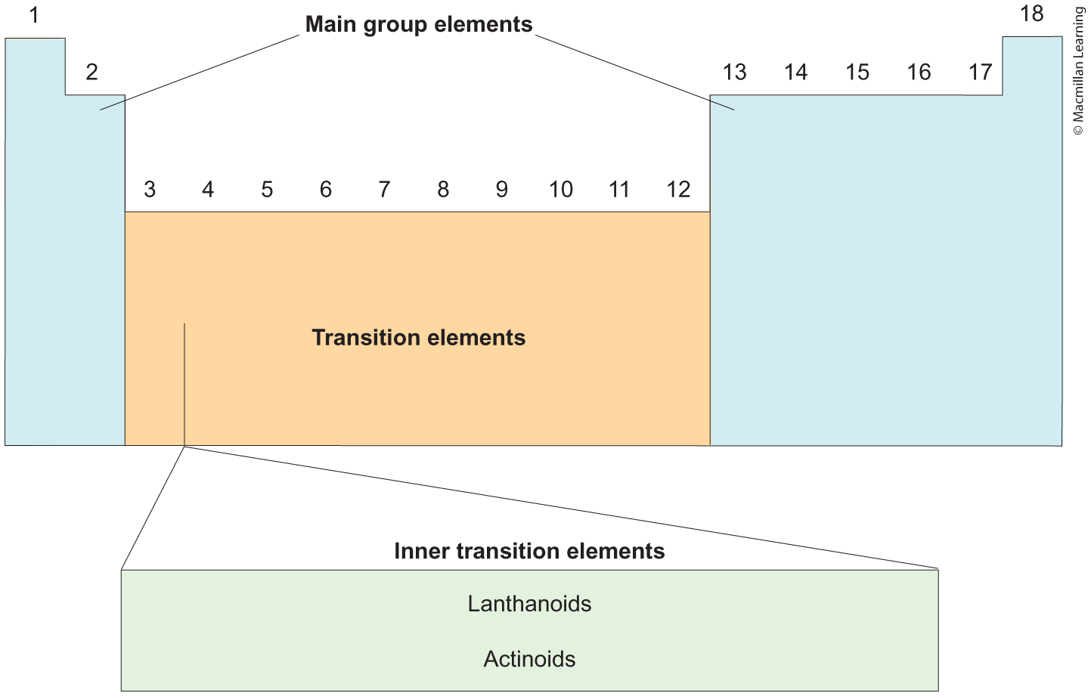

Slide 9
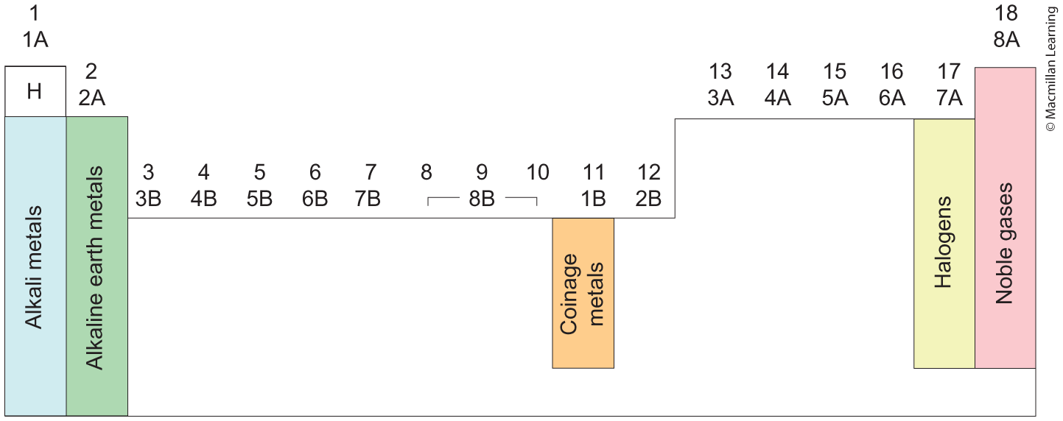
Periodic table - group names

Slide 10
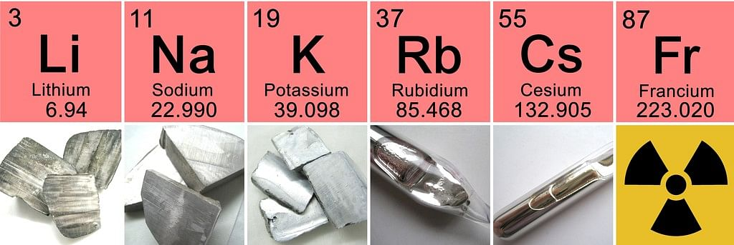
Group 1: alkali metals
Highly reactive elements – due to tendency to lose an electron
DO NOT PLACE IN WATER (https://youtu.be/u20yy-CycGU?si=U1wwkXNuBOh62ufo&t=293)

Slide 11
Group 2: Alkaline earth metals
Oxides of alkaline e.g. MgO, CaO tend to be basic or alkaline
Reactive elements that tend to lose two electrons

Slide 12
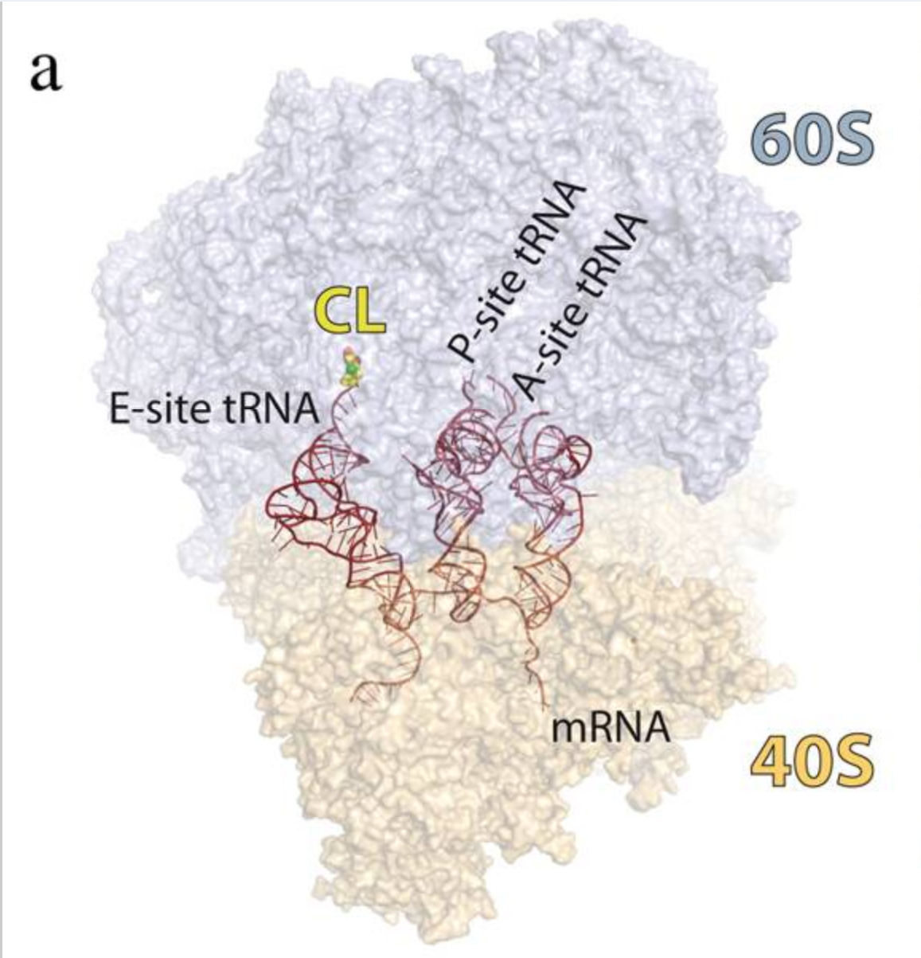
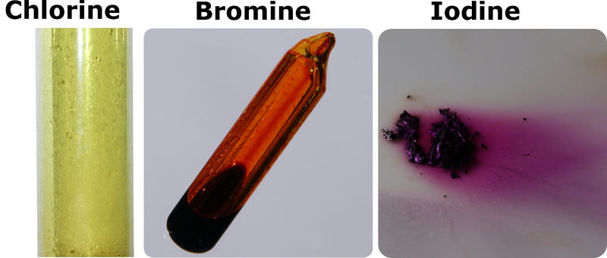
Group 17: Halogen
Reactive elements that tend to gain one electron and nonmetals exists diatomic e.g. F₂, Cl₂, Br₂, I₂
Cancer therapeutic in drug design with Prof Vanderwal (one of my many research projects)

Slide 13
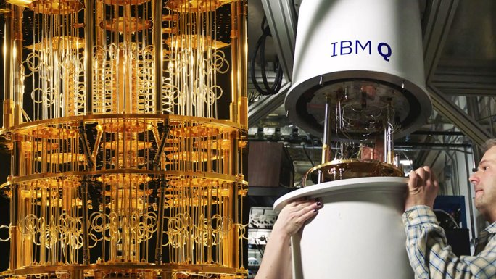
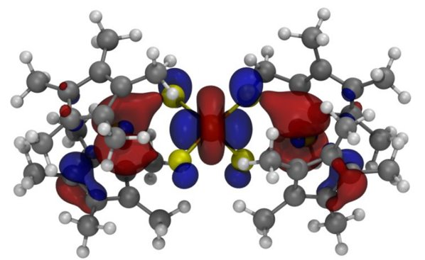
Groups 3-12: Transition metals
Exhibit typical metallic properties such as malleability, ductility, high tensile strength, and shiny
Single molecule magnets with Prof Evans (one of my many research projects)
Quantum computing

Slide 14
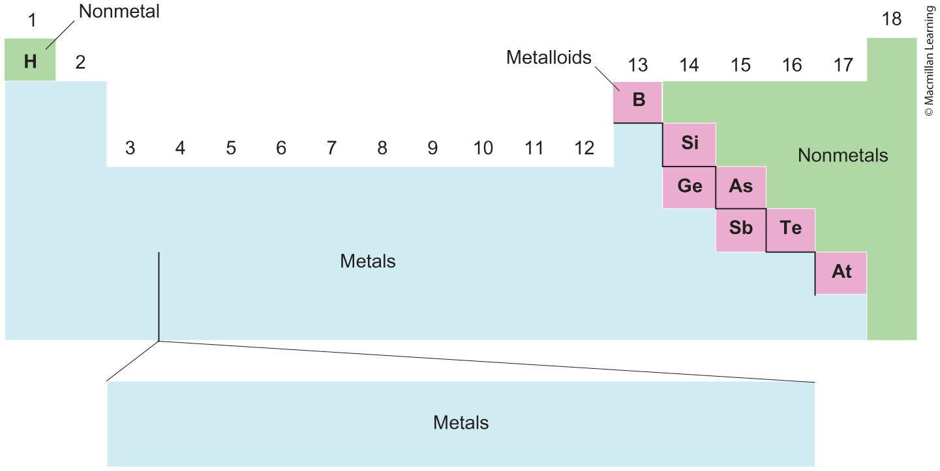
Metals, nonmetals, and metalloids
Metals – malleable, ductile, and shiny
Nonmetals – generally gas phase at room temperature
Metalloids – in between a metal and nonmetal; properties of both

Slide 15
Outline
Announcements
Ch. 2: Interpreting Periodic Table
Ch. 3: Compounds and the Mole
Chemical formulas
Naming ionic and binary covalent compounds, and acids
Mole concept and molar mass
% composition, molecular formula, and empirical formula

Slide 16
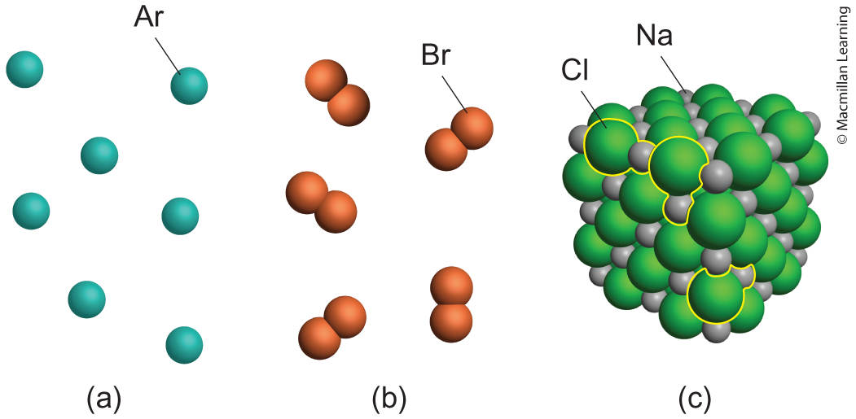
Chemical formulas
Chemical formula represents the ratio of elements within a compound
Subscripts define how many of each element e.g. Ar, Br₂, NaCl
Classify ionic (metal/polyatomic ion+nonmetal/polyatomic ion) vs covalent (nonmetal) compounds

Slide 17
Practice: Determine the number of unique atoms in each compound
Mg(ClO₂)₂
(NH₄)₂SO₄
S₈
H₃PO₄
CH₃CH₂CO₂H

Slide 18
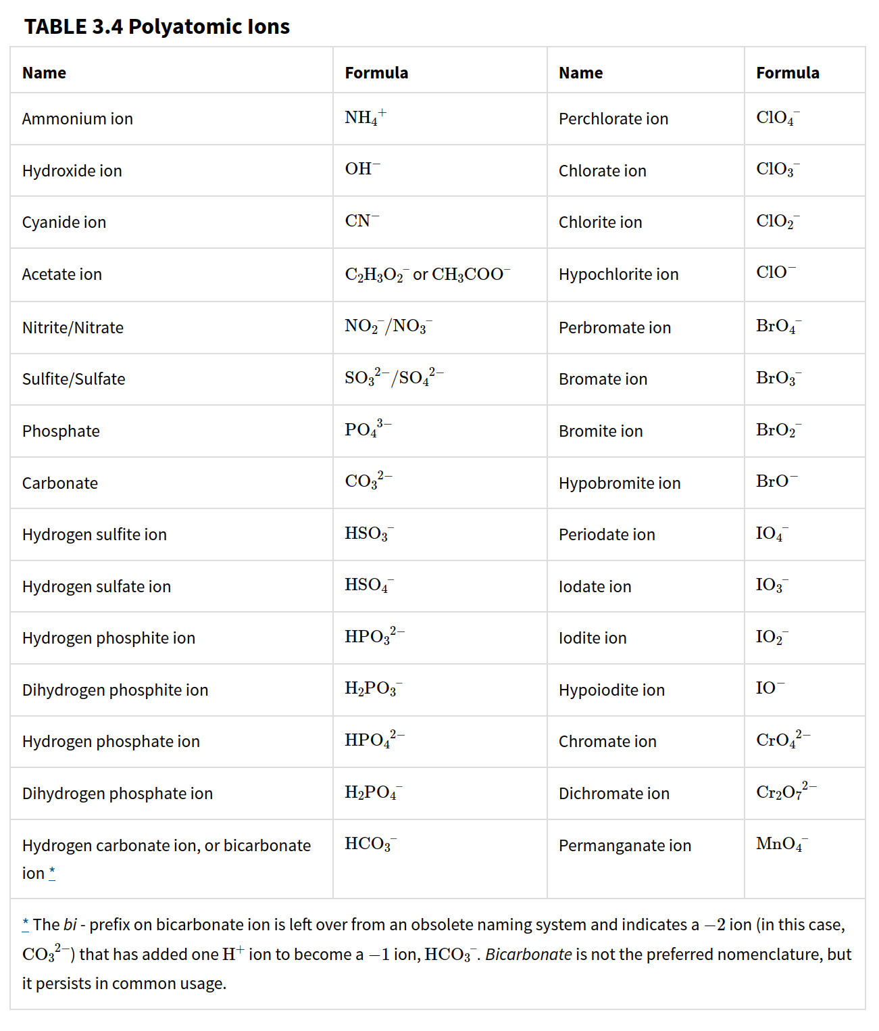

Slide 19
Practice: classify each compound as ionic or covalent
Mg(ClO₂)₂
(NH₄)₂SO₄
S₈
H₃PO₄
CH₃CH₂CO₂H
Fe₂O₃

Slide 20
Outline
Announcements
Ch. 2: Interpreting Periodic Table
Ch. 3: Compounds and the Mole
Chemical formulas
Naming ionic and binary covalent compounds, and acids
Mole concept and molar mass
% composition, molecular formula, and empirical formula

Slide 21
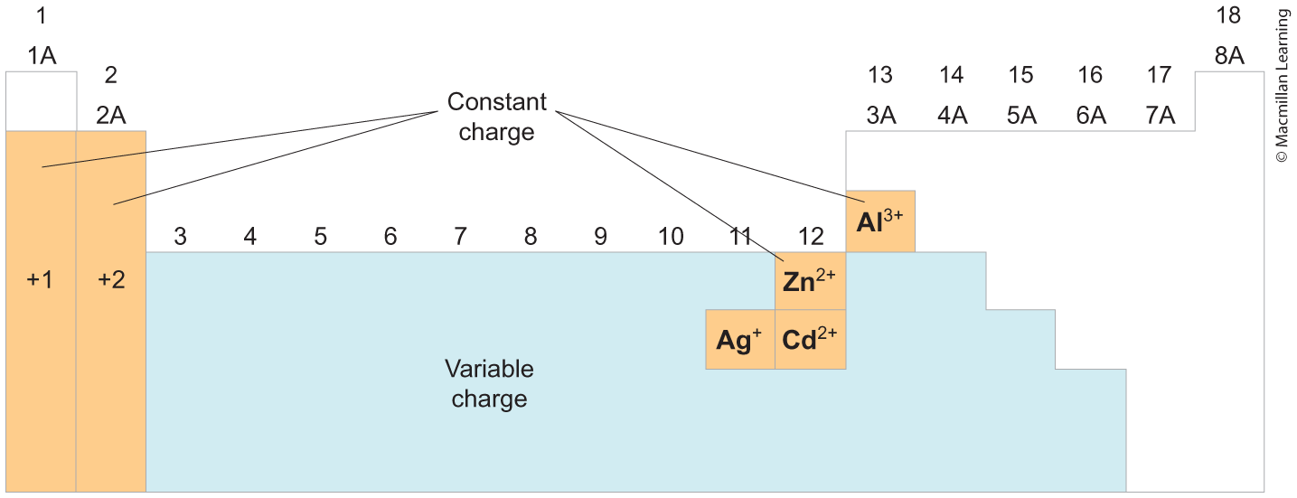
Ionic compounds
Naming cations (positively charged) and anions (negatively charged)

Slide 22
Ionic compounds
Constant charges – Polyatomic ions (memorize), Groups 1-2 and few metal elements
Example:
Ba²⁺ Barium ion
K⁺ Potassium ion
Zn²⁺ Zinc ion
Fe²⁺ Iron(II)
Fe³⁺ Iron(III)

Slide 23
Ionic compounds
Naming anions (negative charged) - Generally nonmetals from Groups 13-17
Add an –ide to the end and ion
Example:
O²⁻ oxide ion
F⁻ fluoride ion
I⁻ iodide ion
N³⁻ nitride ion

Slide 24
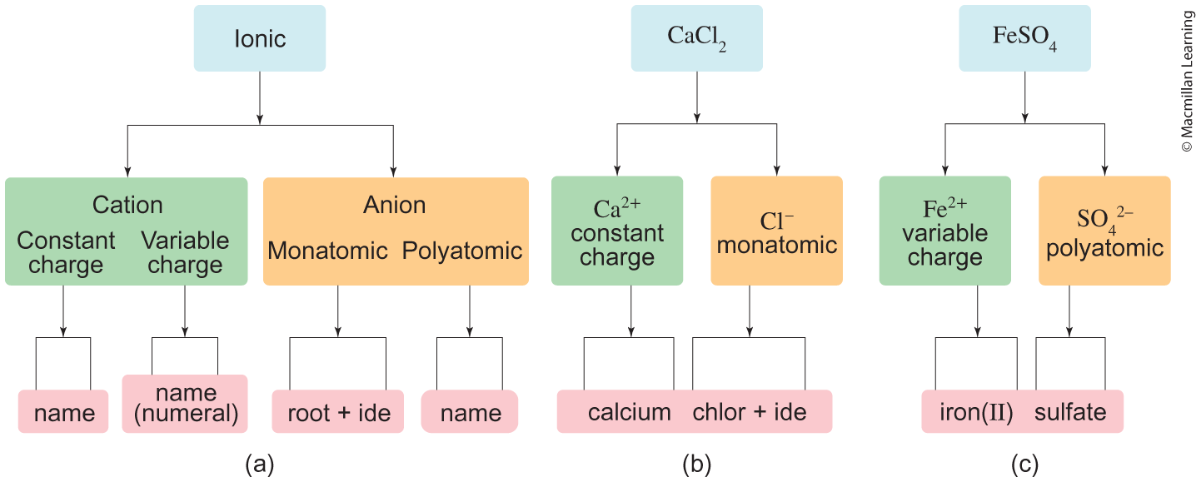
Naming ionic compounds

Slide 25
Practice: naming ionic compounds (forwards+backwards)
BaSO₄
Zinc chloride
Cobalt(III) Oxide
Al₂S₃
Fe₂O₃
Cesium bicarbonate

Slide 26
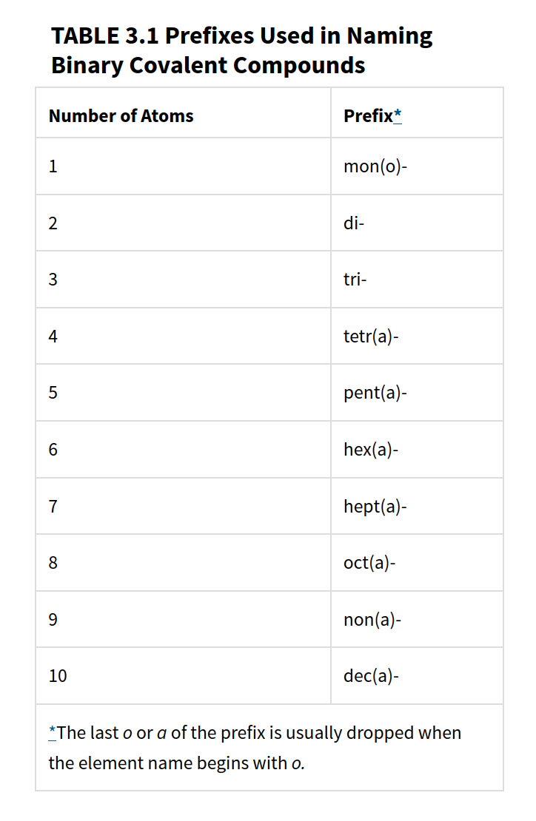
Binary covalent compounds
Binary covalent compounds – made up of 2 nonmetal atoms
Memorize the prefixes – determines the number atoms
Note: if there is only 1 atom for the first atom, omit "mono-" prefix

Slide 27
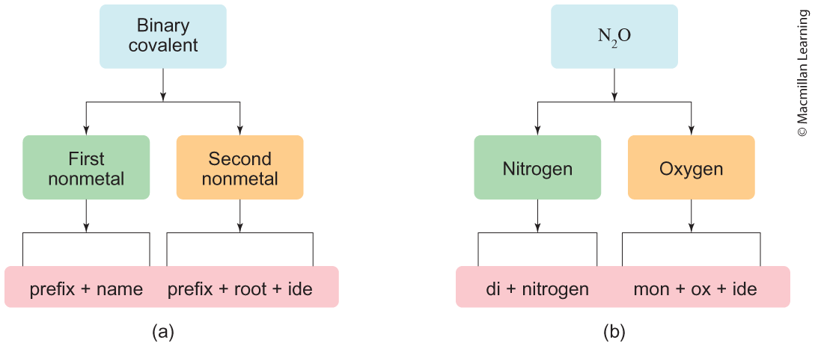
Binary covalent compounds

Slide 28
Practice: Name the following covalent compounds (backwards+forwards)
Dihydrogen oxide
ClO₃
S₄N₄
Diphosphorus pentasulfide
As₂O₅
CBr₄

Slide 29
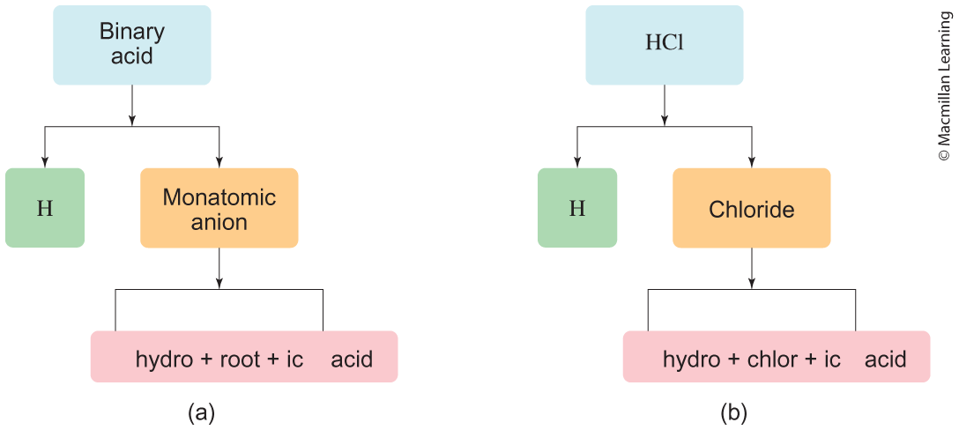
Naming acids
Arrhenius acid (most familiar) – release of proton (H⁺ ion) in solution
Binary acid – H atom(s) bonded to monatomic anion

Slide 30
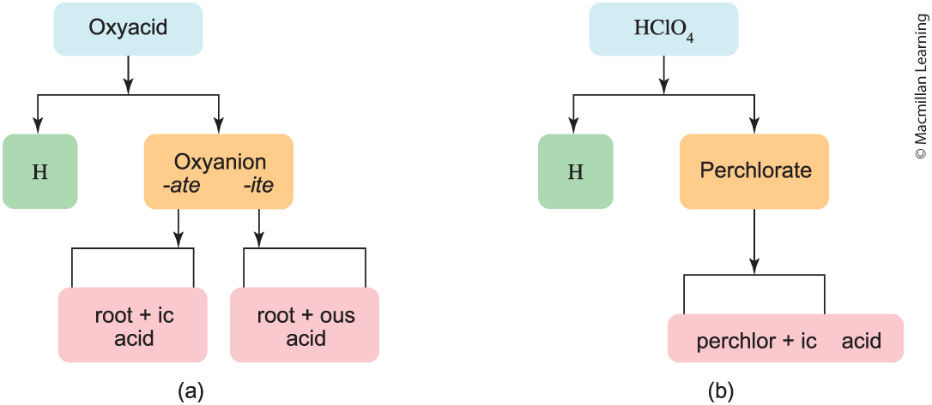
Naming acids
Oxyacid – H atom(s) bonded to oxyanion (ClO₄¹⁻, SO₄²⁻, PO₄³⁻)

Slide 31
Practice: Naming the acids
H₃PO₄
H₂SO₄
HF
Hydrochloric acid
Bromous acid
HNO₃

Slide 32
Outline
Announcements
Ch. 2: Interpreting Periodic Table
Ch. 3: Compounds and the Mole
Chemical formulas
Naming ionic and binary covalent compounds, and acids
Mole concept and molar mass
% composition, molecular formula, and empirical formula

Slide 33
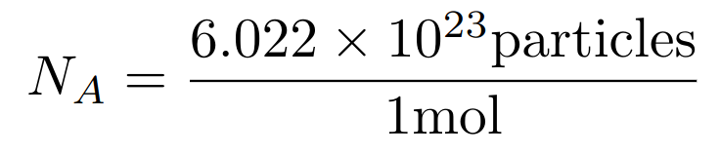
the mole and avogadro's number
Analogy to ratios e.g. 1 dozen eggs is 12 eggs
Avogadro's number (N_{A}) relates to the mole and the number of "particles" (atoms, molecules, or photons – light particles)
Example: How many moles of H₂O are in a drop of water that contains
1.67 x 10²¹ H₂O molecules?

Slide 34
Power of the Mole: atoms in a compound
Sucrose (C₁₂H₂₂O₁₁) is a single molecule made of 12 C atoms, 22 H atoms, and 11 O atoms
Alternative perspective: 1 mol Sucrose – 12 mols C, 22 mols H, and 11 mols O
Indicated by the subscripts!
Examples: Determine the amount of mols per atom within the compound.
1 mol CCl₄
4 mol CCl₄
0.5 mol H₃PO₄

Slide 35
Calculating molar masses

Slide 36
Calculating molar masses
1 atomic mass unit (amu) is equivalent to 1.667 x 10⁻²⁷ kg
Claim: 1.008 amu H is 1.008 g/mol H. Prove that. Hint: Use Avogadro's number (6.022 x 10²³ atoms/mol)

